Slide 1
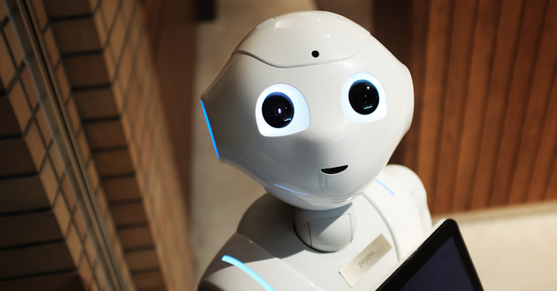
Ethical Concerns in Robotics
Autonomous Weapons, Privacy, Emotional Manipulation & Algorithmic Bias
Your Name • University Name • Date

Slide 2
Team members
1. 0112230416 – Afrin Hossain Trisha
2. 0112231044 – Abasa Mursalat
3. 0112310016 – A M Monoar Hossan Tushar
4. 0112330681 – Md. Akib Mehedi
5. 0112330871 – Khaled Mahmud Shihab

Slide 3
Abstract
Robotics is advancing fast—but with it come serious ethical challenges.
From killer robots to data-collecting vacuums, robots affect human rights, safety, and dignity.
This paper explores five key areas:
1. Autonomous weapons
2. Privacy & surveillance
3.Economic Impacts of Automation: Job Displacement
4. Emotional manipulation in HRI
5. AI bias and discrimination
Goal: Promote responsible and ethical robotics.

Slide 4
Keywords
Robot ethics
Responsible robotics
Killer robots
Surveillance & privacy
Economic Impacts of automation
Emotional manipulation
AI fairness & accountability

Slide 5
Introduction
Robots are in our homes, cities, hospitals—and even battlefields.
Key questions:
- Can they make moral decisions?
- Who is responsible when harm occurs?
- How do we protect privacy and dignity?
Ethics in robotics is no longer optional—it’s essential.

Slide 6

Use Case 1 – Autonomous Weapons
Case: Israel-Gaza Conflict
- Modified DJI drones used for attacks & surveillance
- AI system “Gospel” selects bombing targets
- Risk: Misidentification of civilians as combatants
Ethical Issues:
- Violates Asimov’s First Law
- No empathy or moral judgment
- Lack of accountability and transparency

Slide 7
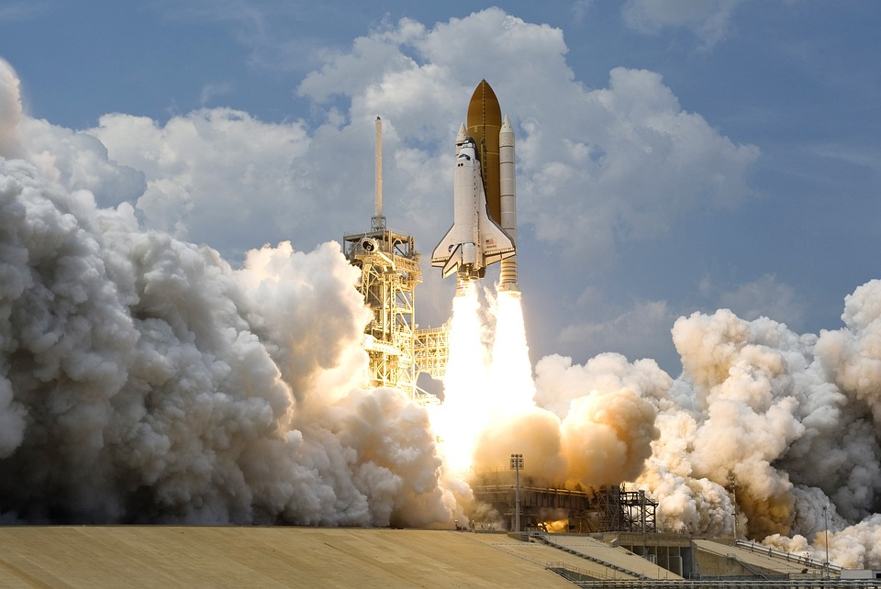
Solutions to Autonomous Weapons
• Human-in-the-loop/on-the-loop oversight
• Legal frameworks & international treaties
• Ensure transparency and human responsibility

Slide 8

Human Dignity & Killer Robots
Killing with a robot removes empathy and moral weight
Machines lack remorse and respect for life
Undermines ethical norms of war and justice

Slide 9
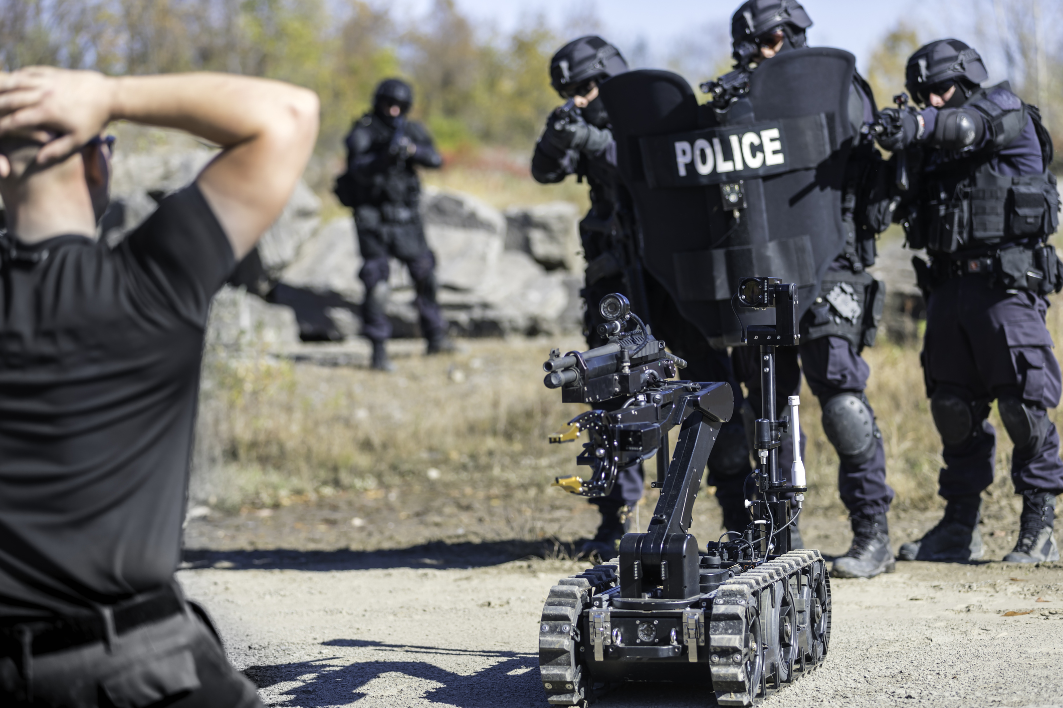
Use Case 2 – Privacy & Surveillance
Robots collect data via cameras, mics, sensors, cloud
Cases:
- Amazon Astro, Roomba leak, Police robots
Concerns:
- Informed consent lacking
- Always-on surveillance
- Data misuse & weak laws

Slide 10

Solutions to Privacy Issues
• Data minimization and secure storage
• Clear user control & transparency
• Stronger, robot-specific privacy laws

Slide 11
Use case-3 Economic Impacts of automation : Job Displacement
How Automation Affects Employment?
- Replaces low-skilled Jobs
- Robots perform routine tasks
-The rise of AI and Robotics raises concerns
-White-collar Jobs in data analysis and legal research

Slide 12
Solutions and Best Practices
-Retraining and reskilling programs
-Consideration of Universal Basic Income (UBI)
-Investment in new Job sector creation
-Support the Gig Economy

Slide 13
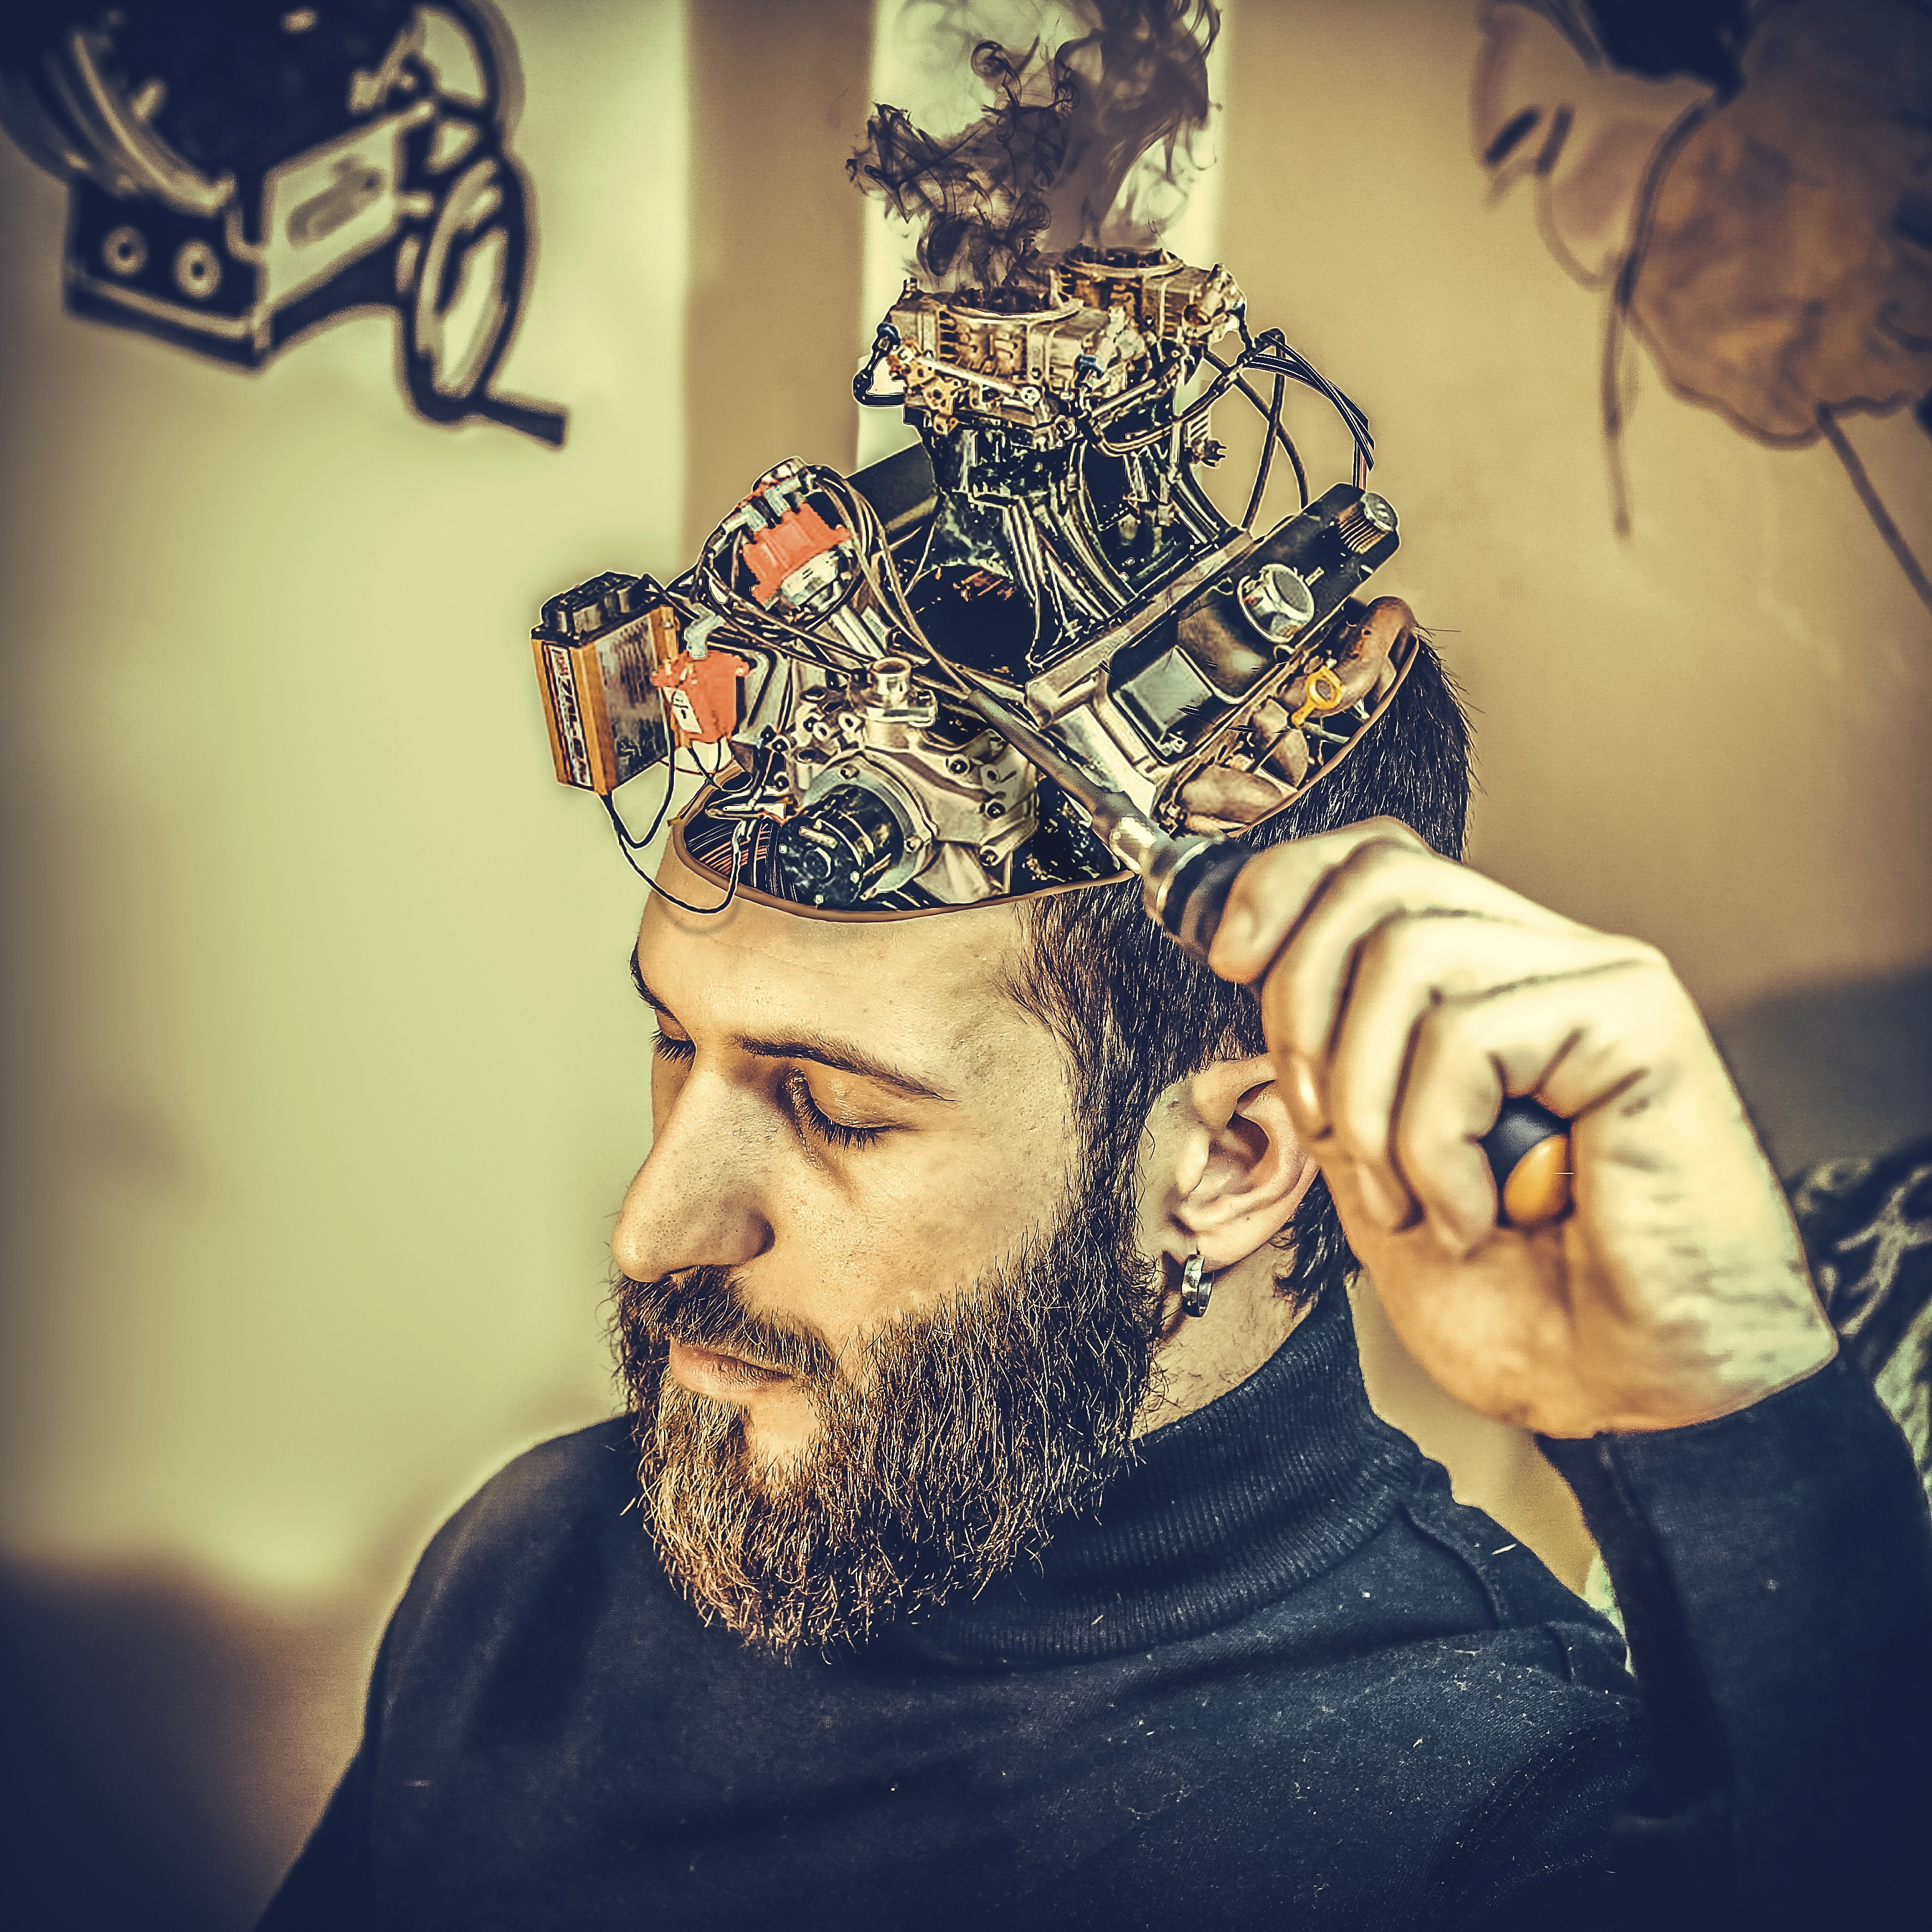
Use Case 4 – Emotional Manipulation
Robots simulate empathy to gain trust
Used in elder care, customer service
Risks:
- Emotional manipulation of vulnerable users
- Blurred lines between real and artificial emotions

Slide 14

Ethical Suggestions for HRI
• Transparency about emotional capabilities
• Ethical behavior design
• User education and regulation

Slide 15

Use Case 5 – Bias & Discrimination
AI systems can reflect and worsen societal biases
Examples:
- Amazon’s hiring AI, healthcare bias, facial recognition errors
Issues:
- Unfair outcomes in jobs, health, policing

Slide 16

Solutions to AI Bias
• Diverse, fair training data
• Regular bias audits
• Explainable AI and ethical oversight

Slide 17

Ethical Themes Across All Cases
• Accountability – Who is responsible?
• Transparency – Can we understand decisions?
• Consent – Are users informed?
• Fairness – Are outcomes equitable?

Slide 18
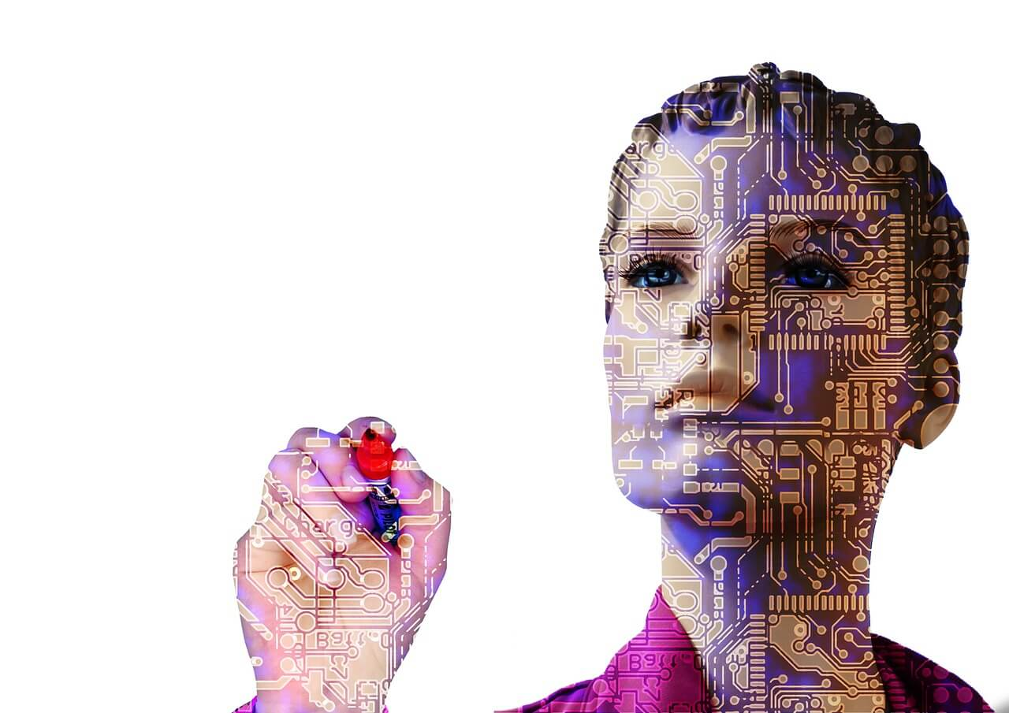
Conclusion
Robots are powerful—but ethics must guide them.
Across all domains, we must embed:
- Fairness, empathy, transparency, human oversight
Technology should uplift humanity, not undermine it.

Slide 19

Discussion / Q&A
Questions to consider:
- Should robots ever be allowed to kill?
- Would you trust an emotional robot?
- How much data should home robots collect?

